Slide 1
DISTRUPTING THE PATH TO VIOLENCE:
Community Heath Worker Orientation

Slide 2
TODAY’S TAKEAWAYS
1
There are often signs that someone is considering violence
2
Promoting awareness of signs helps with the prevention of violence
3
You may be the trusted resource receiving a report about signs of violence

Slide 3
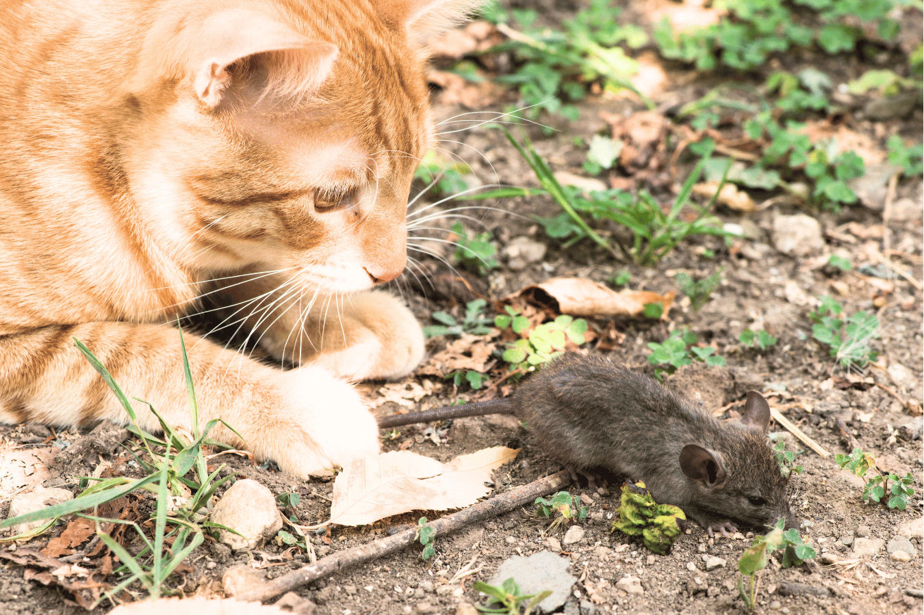
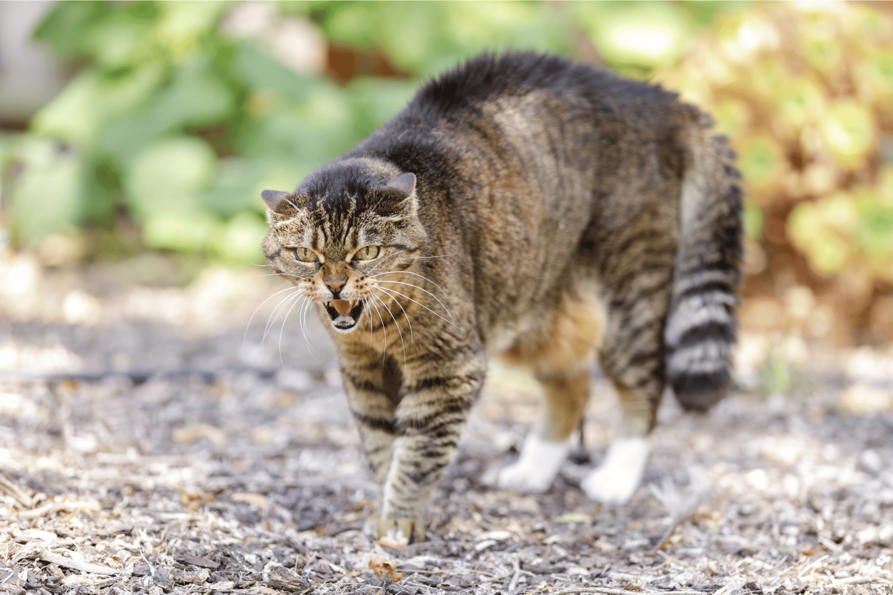
TARGETED VIOLENCE
Targeted violence is planned and involves behaviors that are observable:
Reactive violence is defensive—how you react when you are attacked:
Domestic violence
Stalking
Mass shootings
Workplace violence
Violent extremism
Fights
Defending when attacked
Notes:
There are generally two types of violence. Predatory or Instrumental violence is characterized by hunting behavior. There is an identifiable target with identifiable behaviors as the person(s) move towards an attack. Conversely, affective or reactive violence occurs when someone is threatened. Little planning occurs prior to the violent act.

Slide 4
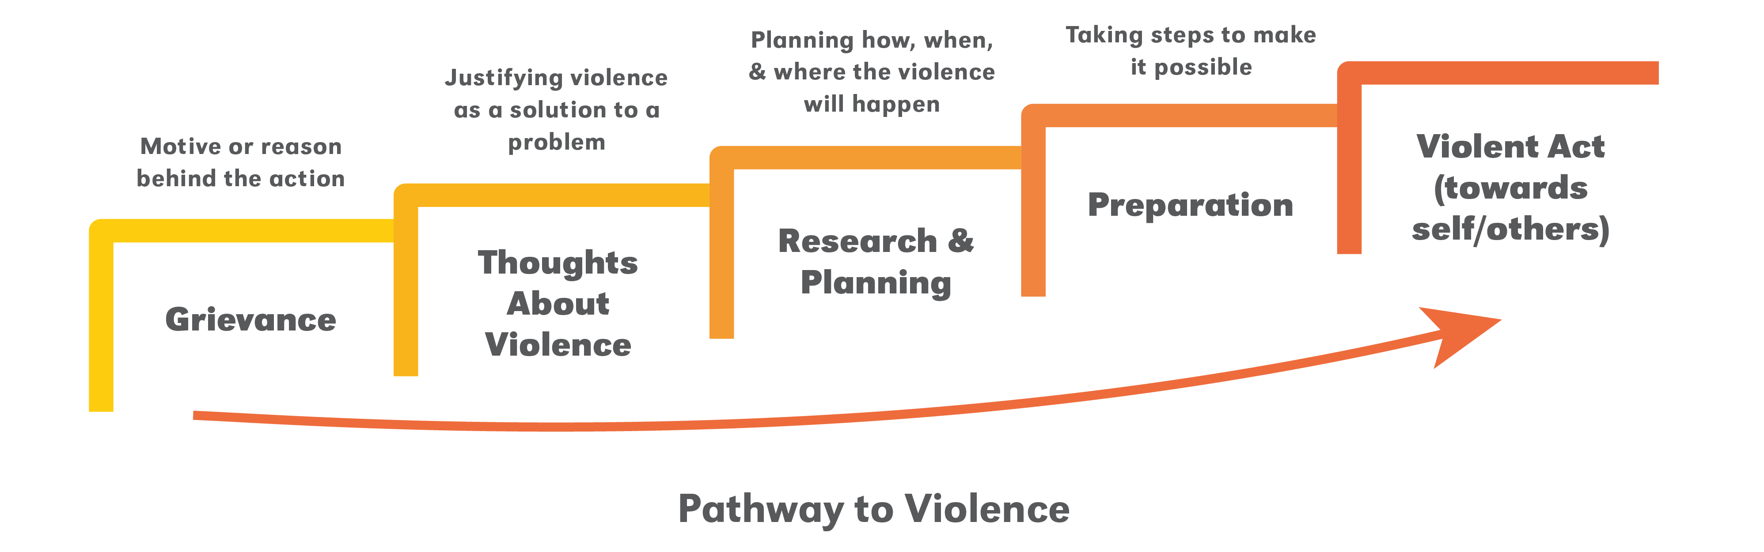
SIGNS SOMEONE IS CONSIDERING VIOLENCE
We look for behaviors and patterns not profiles
Adapted from the Pathway to Violence, Calhoun & Weston, 2003
Notes:
There is no profile for someone who is moving toward targeted violence. Instead, we look for behaviors that may indicate the person is considering violence. This begins with a grievance or motive. The grievance may be real or imagined. Many of us have grievances, but don’t consider violence as an option to solving our issues. We become concerned when a person begins to consider violence as a justified means of solving their problem, addressing their grievance or moving their point of view forward. Examples of behaviors associated with ideation include comments about violence being justified, social media posts glorifying violence. Etc. Another level of escalation occurs when the person begins researching way to carry our a violent act. This can be an internet search, physically shopping for weapons or ammunition, looking at how other attacks have been carried out, etc. This could also include testing security or seeing how close one can get to the target. Once a person begins amassing supplies for the attack, making plans for suicide or breaking social ties they may be in the preparation stage. This is often our final opportunity to intervene before they breach security and carry out an attack.

Slide 5
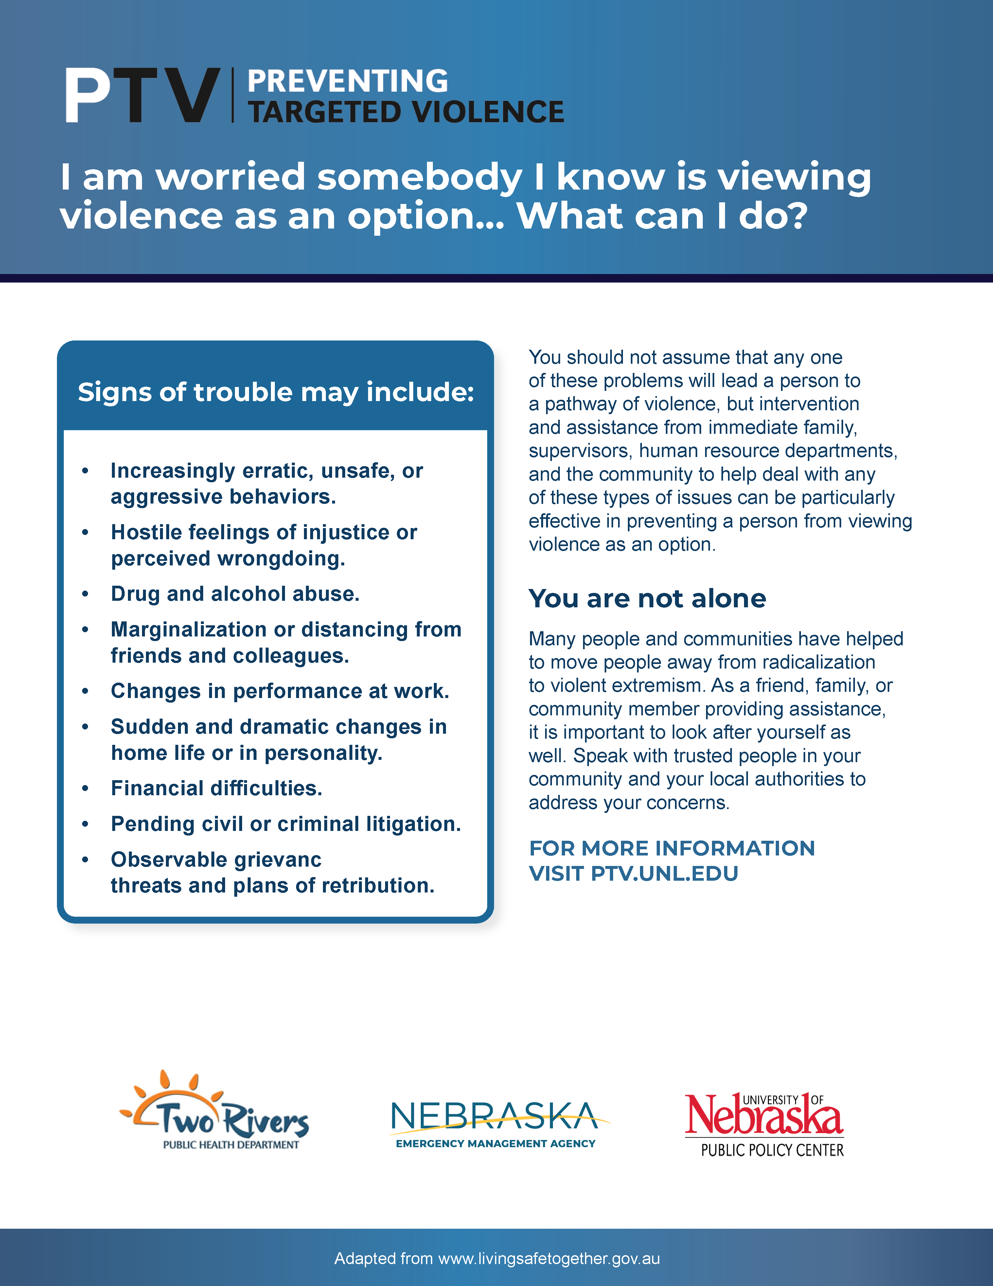
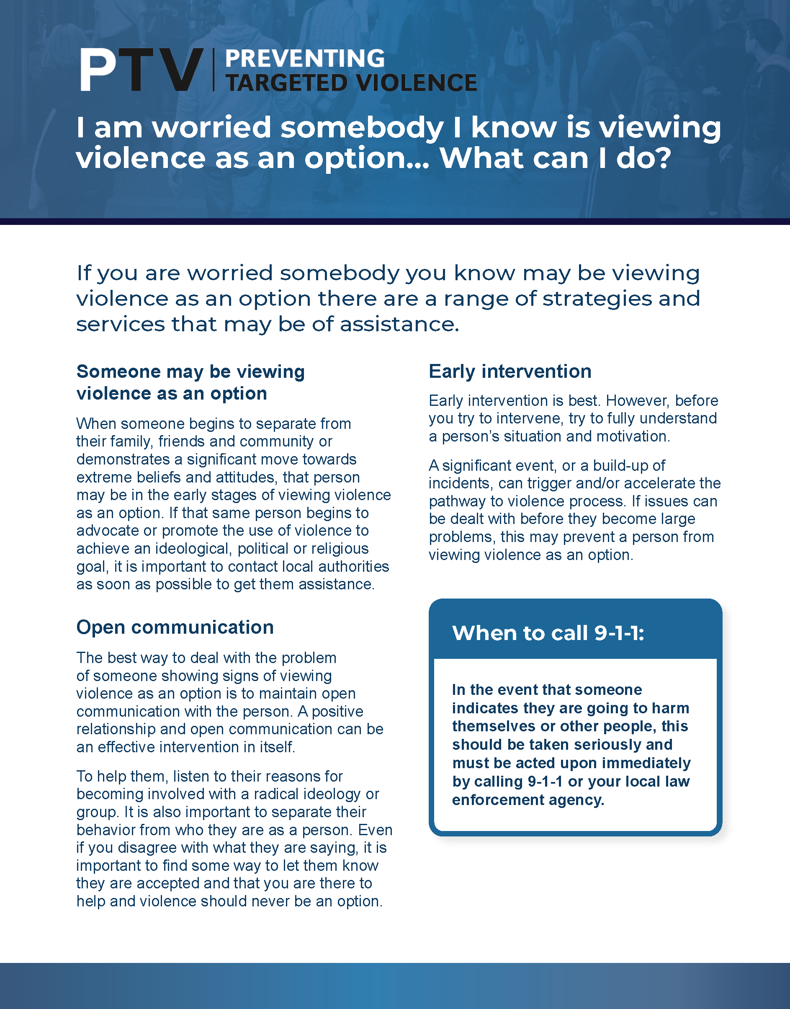
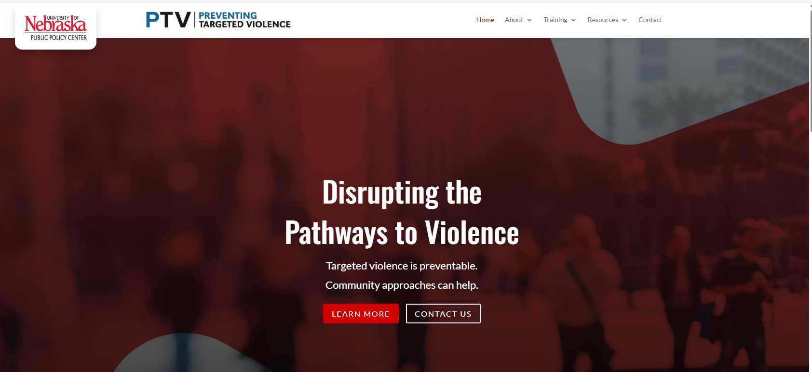
PROMOTING AWARENESS
Visit ptv.unl.edu:
Notes:
An important role for community health workers is to promote awareness in the community about what to look for and report if someone is concerned about violence.
You can educate those you are working with by emphasizing there is no profile and that reporting concerns help move the person off the path to violence.

Slide 6
TRUSTED REPORTING RESOURCE
Reporting is dependent upon…
The behavior of concern
Context (e.g. online, in-person, family, stranger, etc.)
Desire to handle it on their own
Barriers to reporting
Level of intimacy with the person of concern impacts one’s willingness to report (it’s harder to report someone you care about)
Notes:
We understand it is difficult to report someone you love or care about. Generally people hesitate to report behaviors of concern that occur in isolation or only once. They are more apt to report someone if they are a threat to their family but not in their close circle of friends or family. Many decide to handle things on their own or will only tell someone they trust. Recognize there are many different barriers to reporting.

Slide 7
TRUSTED REPORTING RESOURCE
Barriers to reporting…
Concerned it might make the situation worse
Concern about relationships
Reluctance to get involved (it’s personal)
Unsure if behavior should be reported
Prefers to remain anonymous
Concern about how it will be handled
Cultural barriers
Notes:
Some of the barriers include issues surrounding trust. Others reflect a person’s desire to stay out of the situation. Some behaviors are not reported because people don’t recognize the significance of a behavior. Still others may face significant cultural barriers to reporting.

Slide 8
TRUSTED REPORTING RESOURCE
If you receive a report…
1
Get as much information as you can
2
Ensure the reporter is safe
3
Check to see if the reporter is comfortable reporting the information to authorities
*if not, discuss why not & strategies for moving forward
Notes:
As a community health worker, you are viewed as a trusted reporting source. Thus, you may be the one who receives a report. Follow these three steps if you get a report.
First, relax. And get as much information as you can about their concern.
Second, make sure the person making the report is safe.
And third, check with the reporter to see if they are okay with you involving others who may be able to help them more than you can.

Slide 9
TRUSTED REPORTING RESOURCE
If the reporter is hesitant…
Talk about hesitancies
Address any misconceptions
Help facilitate the reporting with authorities
*reassure that they are safe to report
Help the reporter make a safety plan
*bring other resources to help with safety planning
Notes:
If they hesitate to let you involve other people, talk about why they are hesitant and what you might do to help assuage their concerns. If needed, help the reporter make a plan to stay safe.

Slide 10
TODAY’S TAKEAWAYS
1
There are often signs that someone is considering violence
2
Promoting awareness of signs helps with the prevention of violence
3
You may be the trusted resource receiving a report about signs of violence

